Slide 1




Astronomy 1010 chapter 7
Clayton State University
Slides for Astronomy textbook from OpenStax
https://openstax.org/books/astronomy/

Slide 2
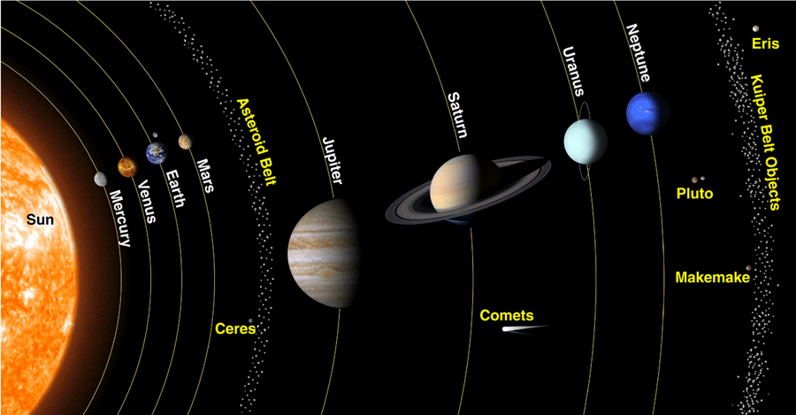
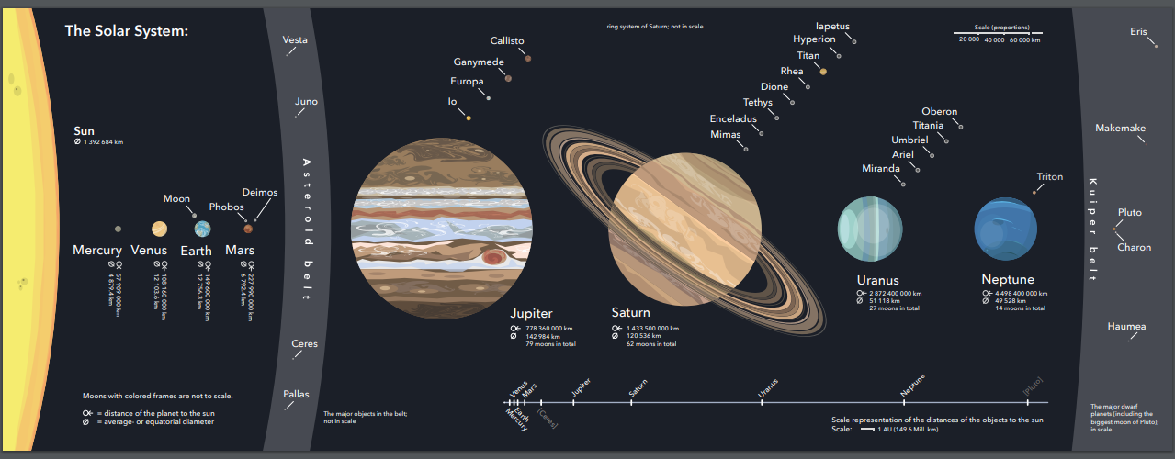
Solar System in modern view
4 inner planets: dense, rocky, small, few to no moons
4 outer planets: gaseous, large, many moons, rings (some)
Asteroids, dwarf planets, Kuiper belt, Oort cloud (?).

Slide 3
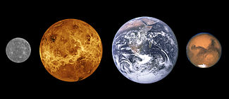
Inner Planets
Mercury (vintage photo), Venus (reconstructed), Earth, Mars
Relative sizes.
Rocky
High density
Small size
Little to no moons, no rings

Slide 4
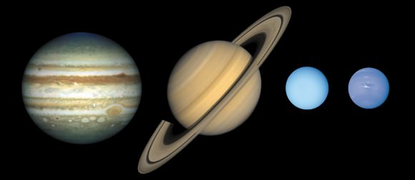
Outer Planets
Jupiter, Saturn, Uranus and Neptune
Large
Low density
Made from gas
Rings, large number of the moons

Slide 5
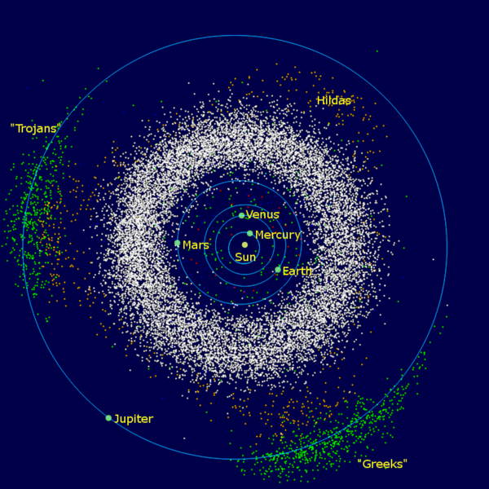
Asteroid belt
Between Mars and Jupiter
Special ‘Trojan’ asteroid groups
Move in synch with Jupiter
In Lagrange points

Slide 6
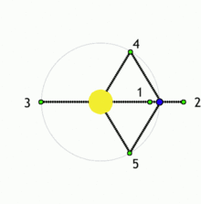
Lagrange points
Lagrange points are the points near two bodies orbiting each other, where a smaller object will maintain its position relative to the large orbiting bodies.
At other locations, a small object would go into its own orbit around one of the large bodies, but not at Lagrange points
At Lagrange points the gravitational forces of the two large bodies, the centripetal force of orbital motion, and (for certain points) the Coriolis acceleration all match up in a way that cause the small object to maintain a stable or nearly stable position relative to the large bodies.
There are five such points labeled L1 to L5. All five are in the orbital plane of the two large bodies, for each given combination of two orbiting bodies (e.g., Sun and a given planet)

Slide 7
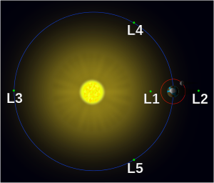
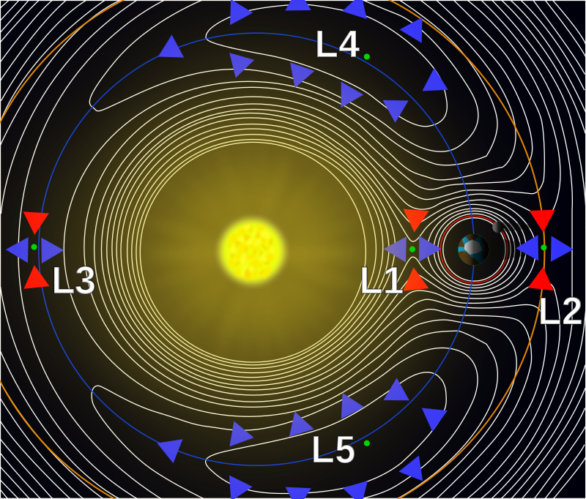
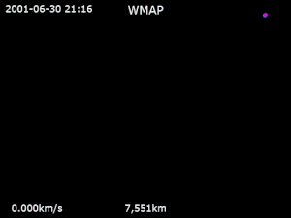
Orbits in L points
Example of a satellite orbiting L2

Slide 8
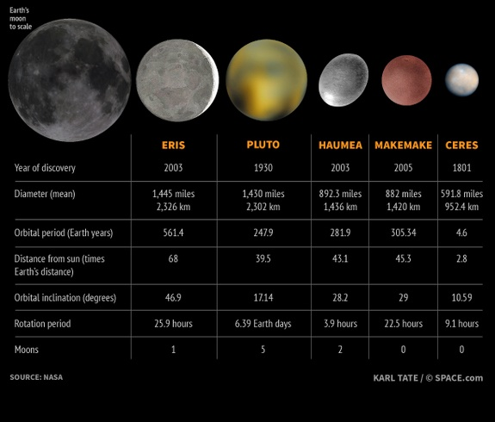
Dwarf Planets
Kuiper Belt Objects
Share similar composition (different from inner and outer planets)
Share orbital characteristic, such as higher eccentricity and outside of ecliptic plane
Many have been discovered

Slide 9
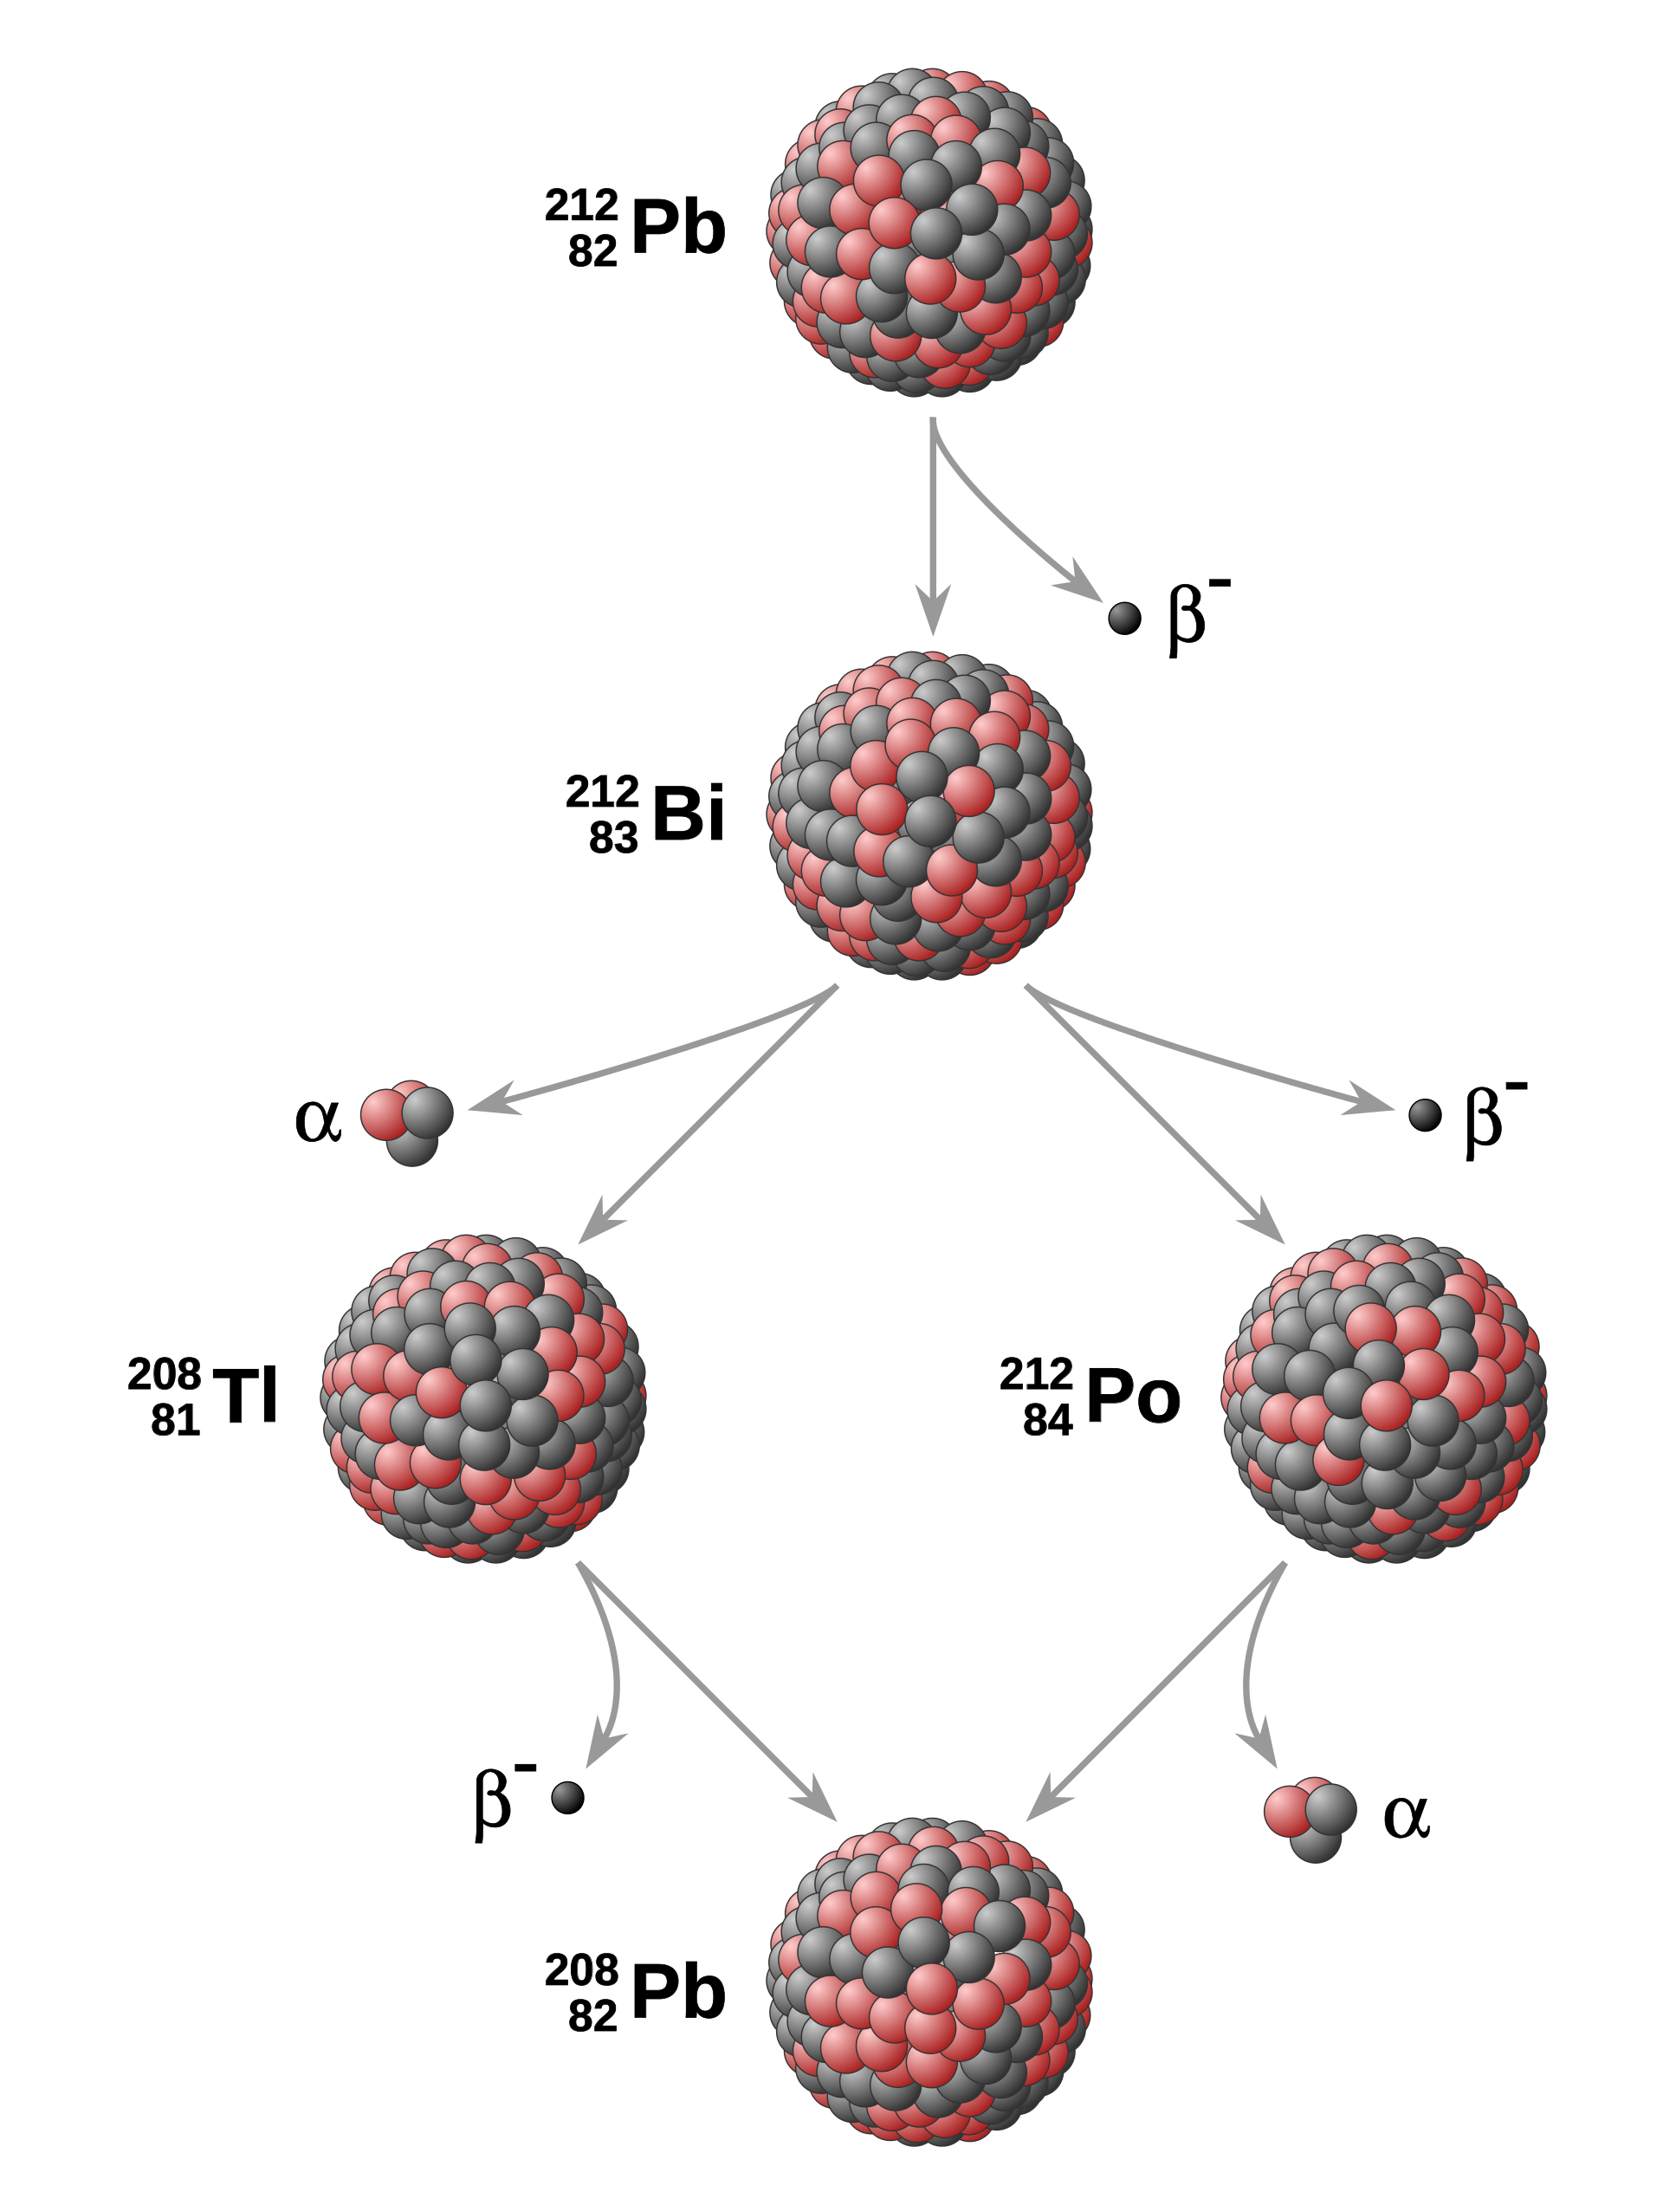
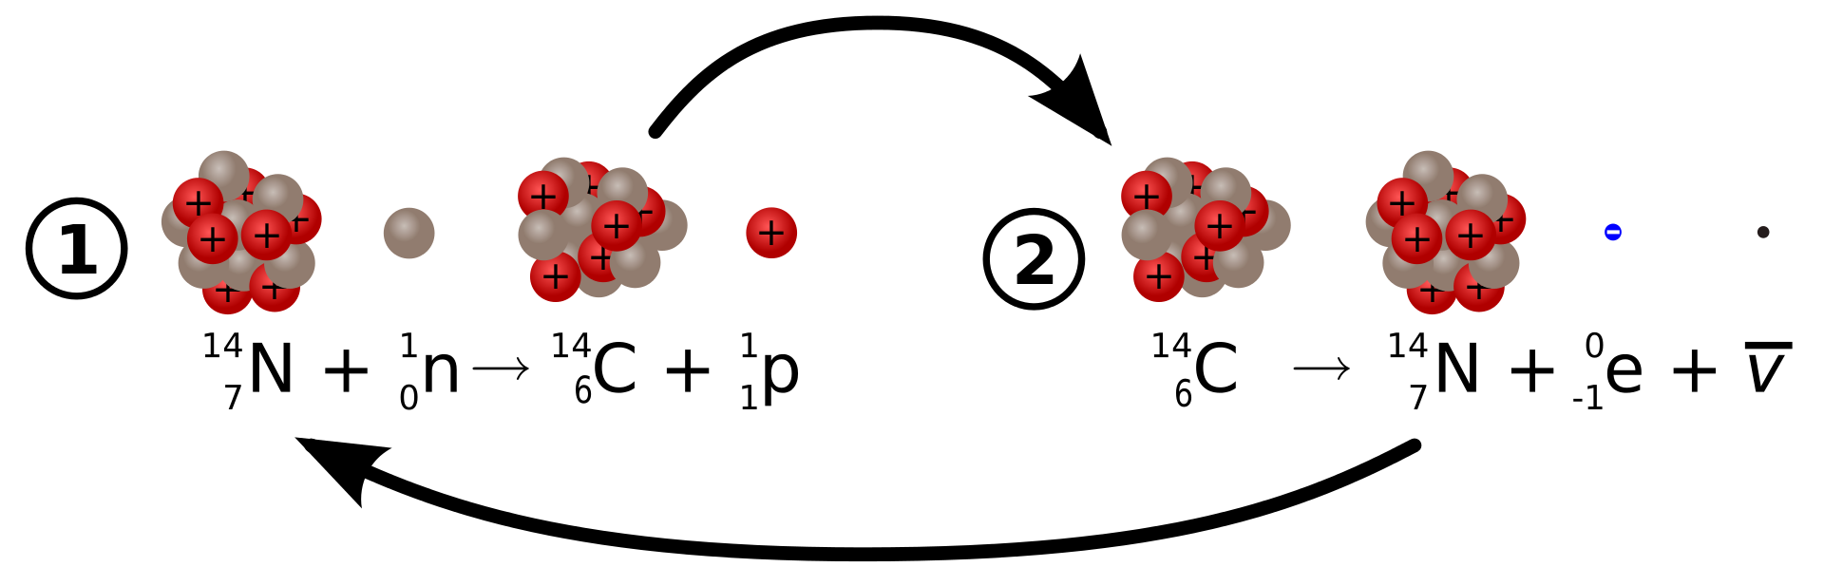
How can we date something?
There are many isotopes (version of the nucleus) for all elements that are unstable
  Isotope nuclei are different by number of neutrons
Some heavy elements past lead don’t have stable isotopes
If we know that some isotope was present in sample, we can measure how much is left and calculate time passed
Or we can find decay products and calculate how much time had to pass for the parent nucleus to decay and produce the measured about
Can date fossils (carbon dating) and even rocks

Slide 10
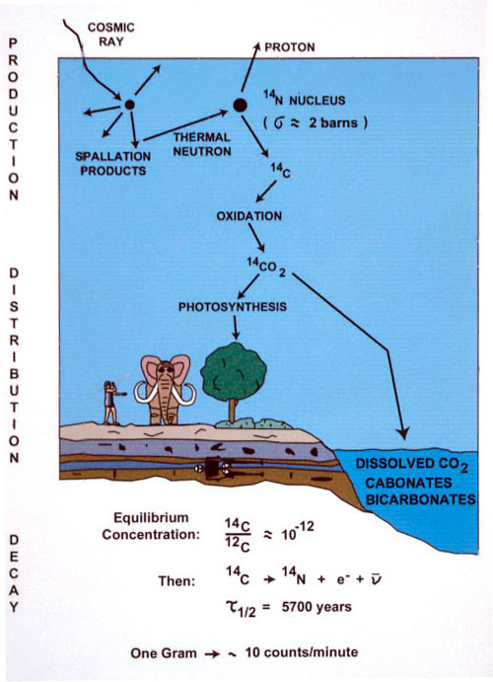
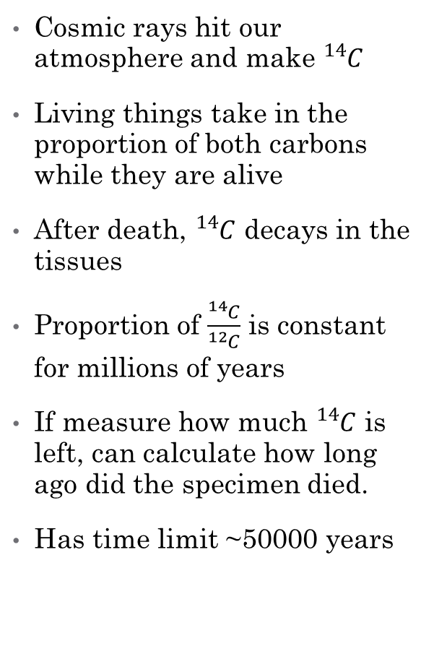
Carbon Dating
Cosmic rays hit our atmosphere and make ${}_{ }^{14}C$
Living things take in the proportion of both carbons while they are alive
After death, ${}_{ }^{14}C$ decays in the tissues
Proportion of $\frac{{}_{ }^{14}C}{{}_{ }^{12}C}$ is constant for millions of years
If measure how much ${}_{ }^{14}C$ is left, can calculate how long ago did the specimen died.
Has time limit ~50000 years

Slide 11
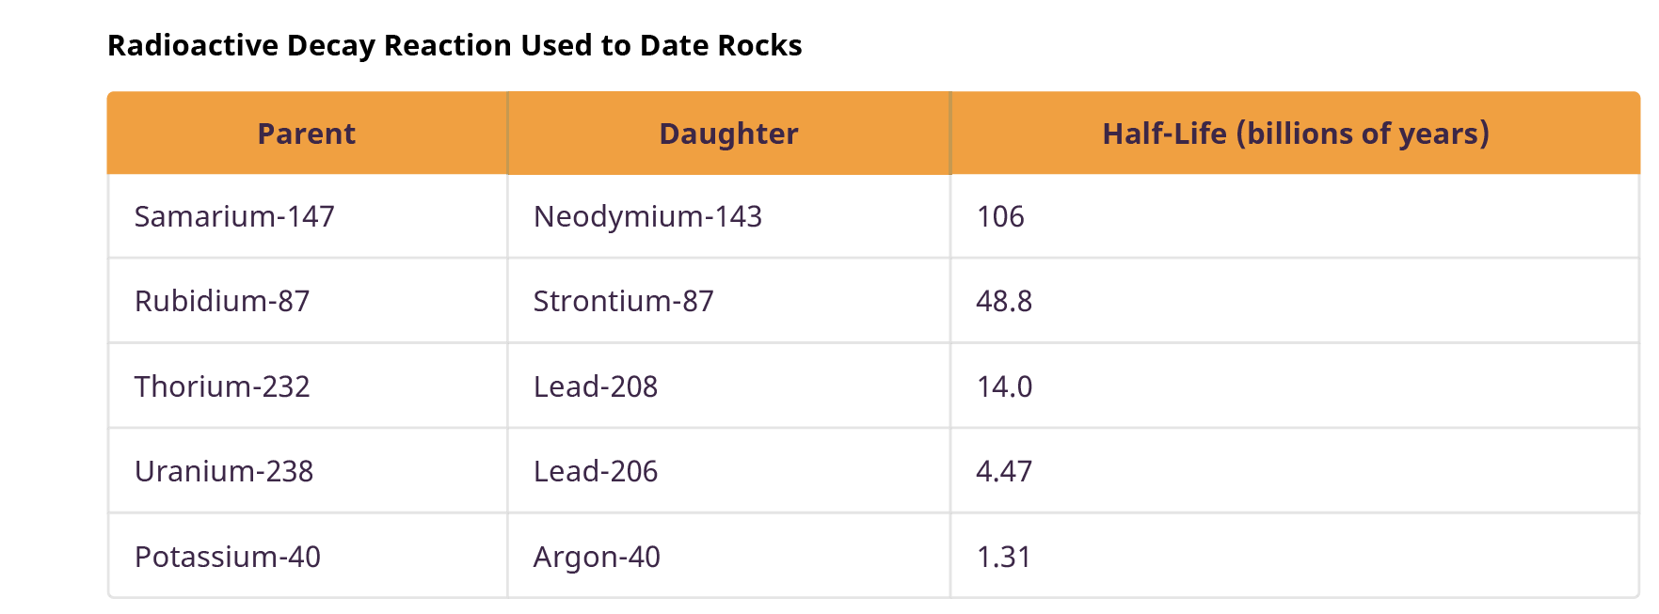
Dating rocks
Table 7.3 from textbook lists commonly used isotopies for dating rocks
Each isotope has different range and precision
Usually, can find more then one in a given sample
Recall that Solar system is less then 5 billion years old!

Slide 12
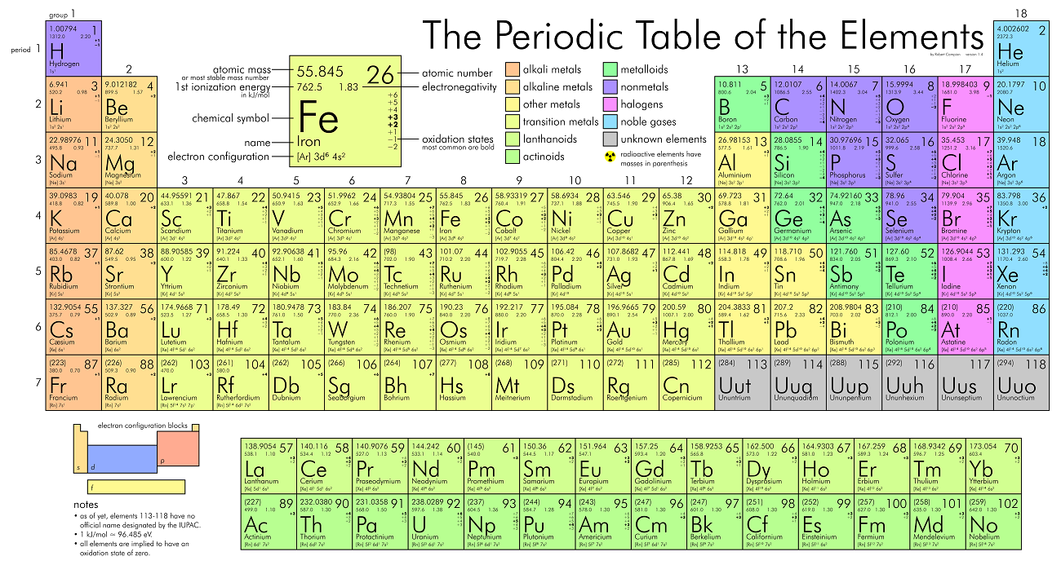
Periodic table of elements
The mass of each element is the weighted average of naturally occurring isotopes

Slide 13

Any Questions?

